Slide 1

V-Guard Sentinel
One AI Core that makes the home inverter and its battery self-aware — predicting failure, learning the home, acting on its own, offline.
Track 4 · Reimagining V-Guard for an AI-Powered Era — From Smart Products to Intelligent Products
Team Codey Tingle (TI3271) · Ayush Manoj Garg · Eshan Shukla · Tanay Chaplot
Finale · Kochi · 24 September 2026

Slide 2
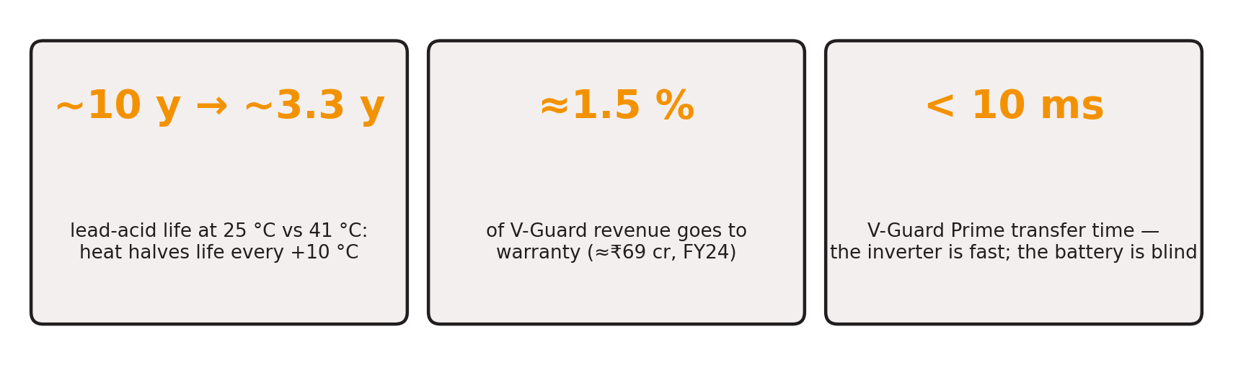
The battery is the silent point of failure
Every Indian home inverter is fast at switching and blind about the one part that actually fails
▪ The pain: a tubular battery dies without warning — food spoils, work stops, the replacement is a ₹15–18 k surprise
▪ The cost to V-Guard: early failures land inside the flat warranty window; today's inverters sense voltage and current but turn none of it into foresight
▪ The gap: no Indian competitor ships on-device battery remaining-life prediction, autonomous load prioritisation, or offline appliance intelligence
V-Guard Sentinel · Big Idea Tech 2026, Track 4 · Team Codey Tingle (TI3271)
2

Slide 3
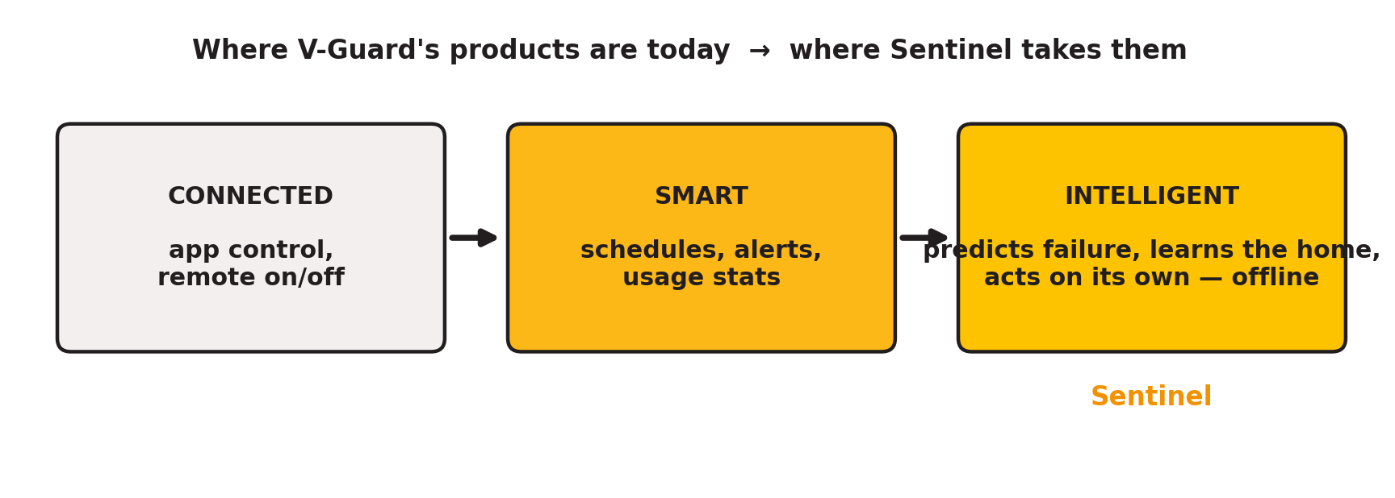
The idea: from smart to intelligent
Smart products take commands. Intelligent products predict, learn and act — and do it without the cloud
▪ Sentinel is a small module — embedded in new V-Guard inverters, retrofitted to the installed base — that runs four intelligence engines on a ₹300 microcontroller
▪ Offline-first by design: every core function works with zero internet, which in India is a virtue, not a compromise
V-Guard Sentinel · Big Idea Tech 2026, Track 4 · Team Codey Tingle (TI3271)
3

Slide 4
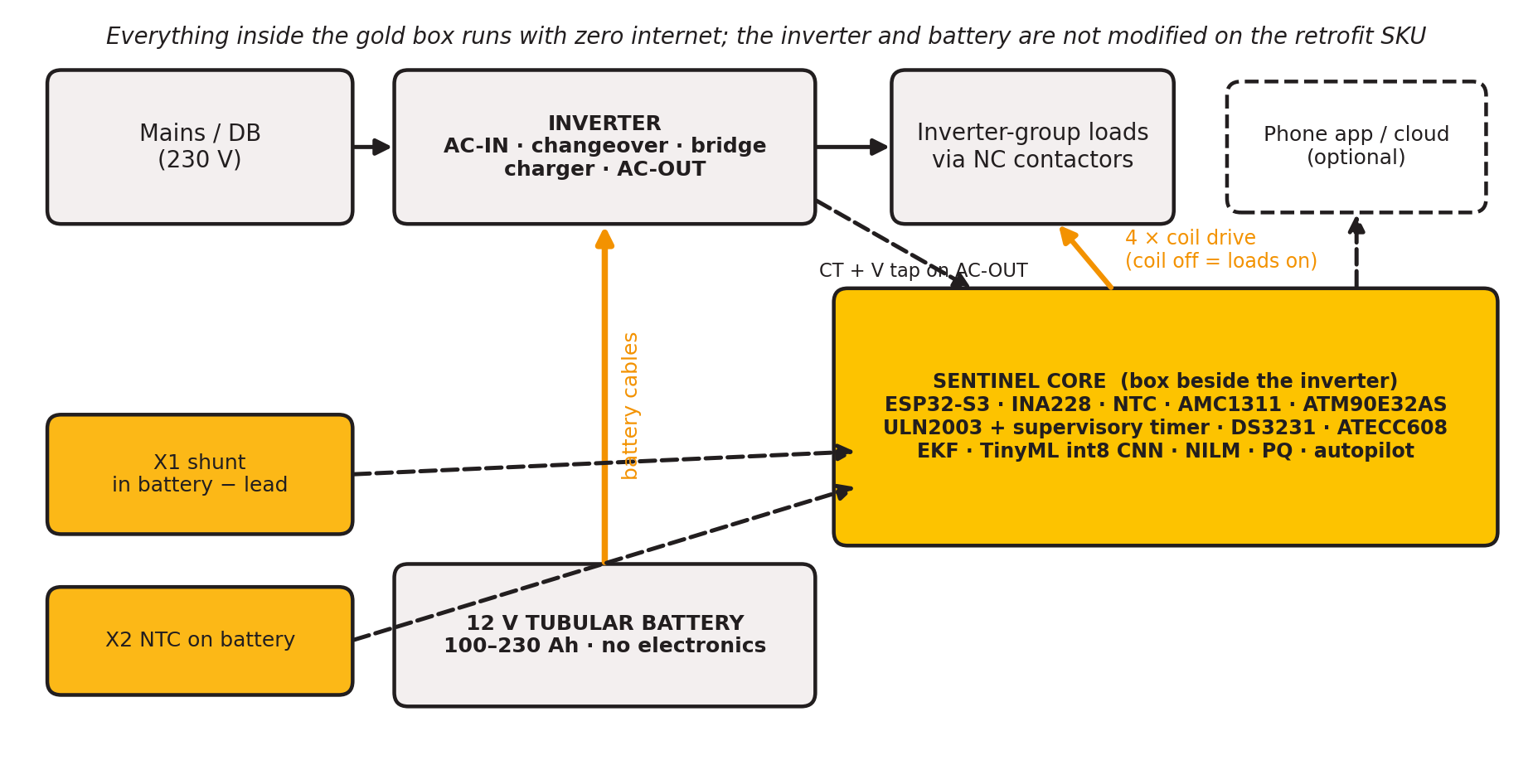
What Sentinel physically is
A box beside the inverter: it reads the battery, watches the AC output, and switches loads through fail-safe contactors
V-Guard Sentinel · Big Idea Tech 2026, Track 4 · Team Codey Tingle (TI3271)
4

Slide 5
Four engines, one core
1 · Battery Health
2 · Habit Autopilot
3 · Energy Coach & Grid Shield
4 · Fleet Intelligence
Coulomb counting + Kalman filter fuse current, voltage and temperature into state of charge and internal resistance. A 28 k-parameter int8 network turns each outage cycle into a state-of-health band and a graded warning: “replace within 6–14 weeks”.
Signed health log → one-tap, data-backed warranty.
Learns the home's load and outage rhythm in a 7×24 table. Detects a blackout in under 2 s by a 2-of-3 vote, then sheds heavy loads by tier with hysteresis so the fridge, lights and router last longest.
Coil off = loads on: every fault fails safe.
A metering front-end on the inverter output gives real and reactive power. Event-based appliance recognition names the big loads and their kWh; half-cycle RMS logs sags, swells and interruptions as appliance-protection evidence.
Consented, pseudonymised per-cycle summaries (~1 KB/day) train better models centrally and return over the air. The moat is V-Guard's own fleet and aging data.
Federated learning is designed (Flower, DP-FTRL) and deliberately on hold.
Same core, same sensors, different models: the platform extends to pumps, stabilisers and water heaters.
V-Guard Sentinel · Big Idea Tech 2026, Track 4 · Team Codey Tingle (TI3271)
5

Slide 6
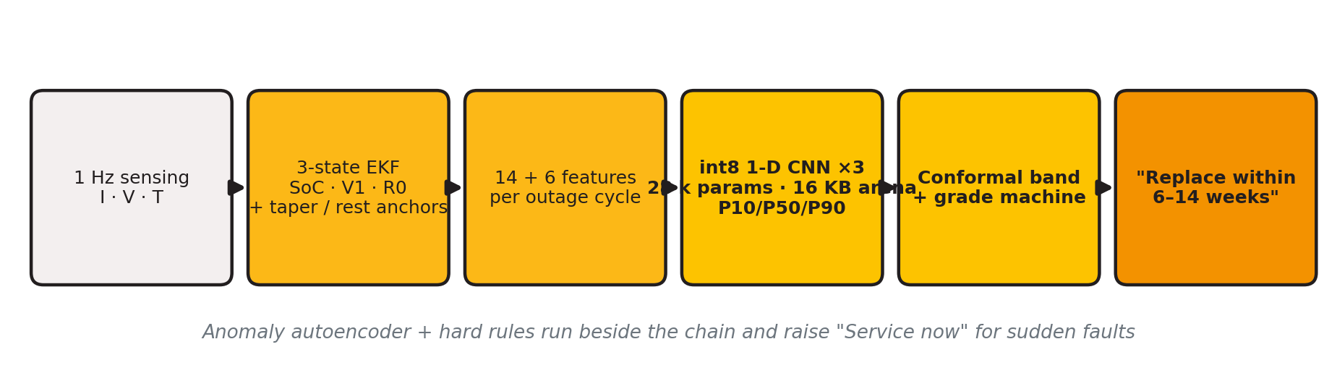
Engine 1 · How the ESP32 predicts battery life
Physics first, learning second: the model only sees quantities the lead-acid lifetime literature says govern wear
▪ Estimator: 3-state extended Kalman filter (SoC, polarisation, R0); SoC re-anchors at 100 % on charge-current taper and to the OCV table only after a true rest with the charger off
▪ Features: resistance and sag vs the battery's own baseline, throughput, depth of discharge, coulombic efficiency, charge acceptance, dQ/dV, Arrhenius heat stress
▪ Model: 1-D CNN over the last 30 cycles, three seeds averaged, quantile heads P10/P50/P90 with conformal calibration — a window, never a date; 16 KB of RAM, ~1–10 ms per inference
V-Guard Sentinel · Big Idea Tech 2026, Track 4 · Team Codey Tingle (TI3271)
6

Slide 7
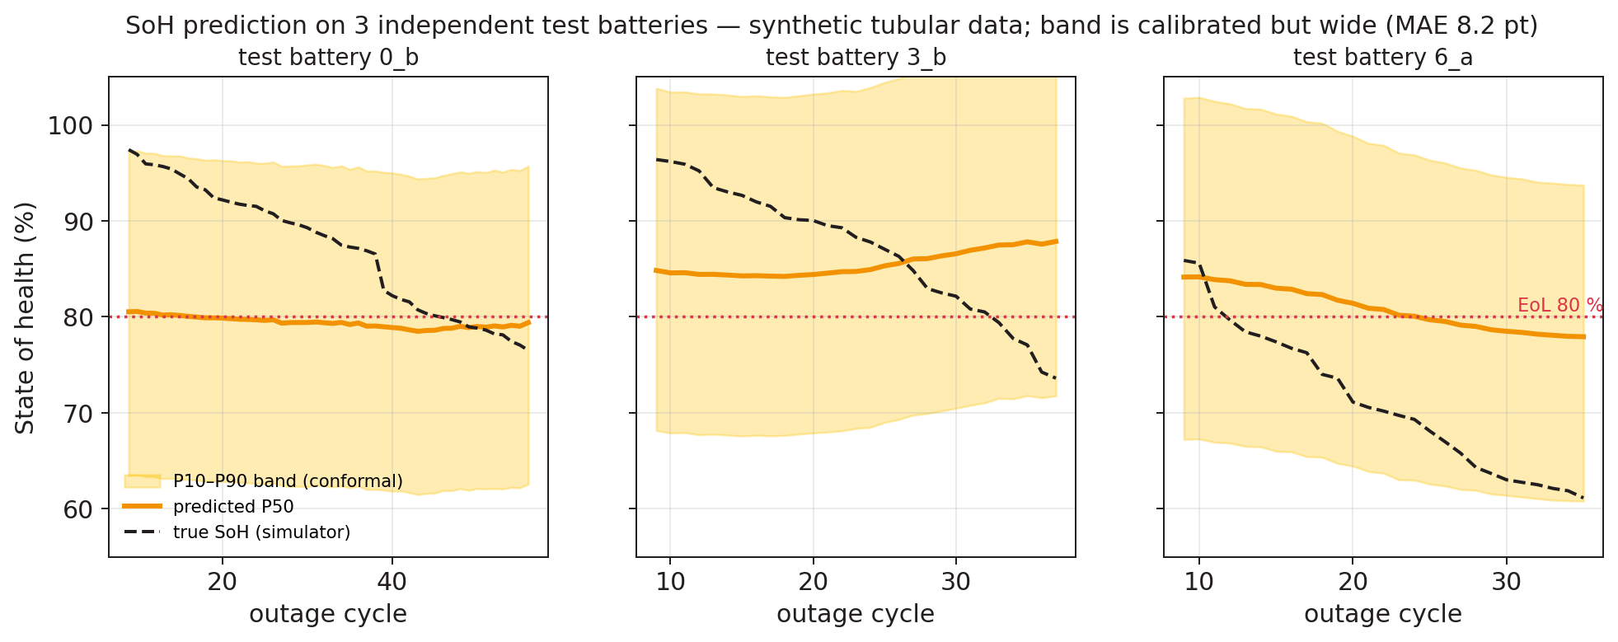
Engine 1 · What the prototype measures today
All numbers from synthetic tubular batteries with an independent, never-touched test split — honest, not flattering
SoH MAE / RMSE
8.2 / 9.6 pt
target ≤ 3 pt after the aging campaign
80 % band coverage
0.66 → 0.99 after conformal
calibrated but too wide (34 pt) on 3 batteries
EKF SoC error
±3 % RMS
vs 7 %/week drift for a naive counter
int8 vs float
+0.01 pt
3 seeds → 3 × 36.7 KB .tflite
V-Guard Sentinel · Big Idea Tech 2026, Track 4 · Team Codey Tingle (TI3271)
7

Slide 8
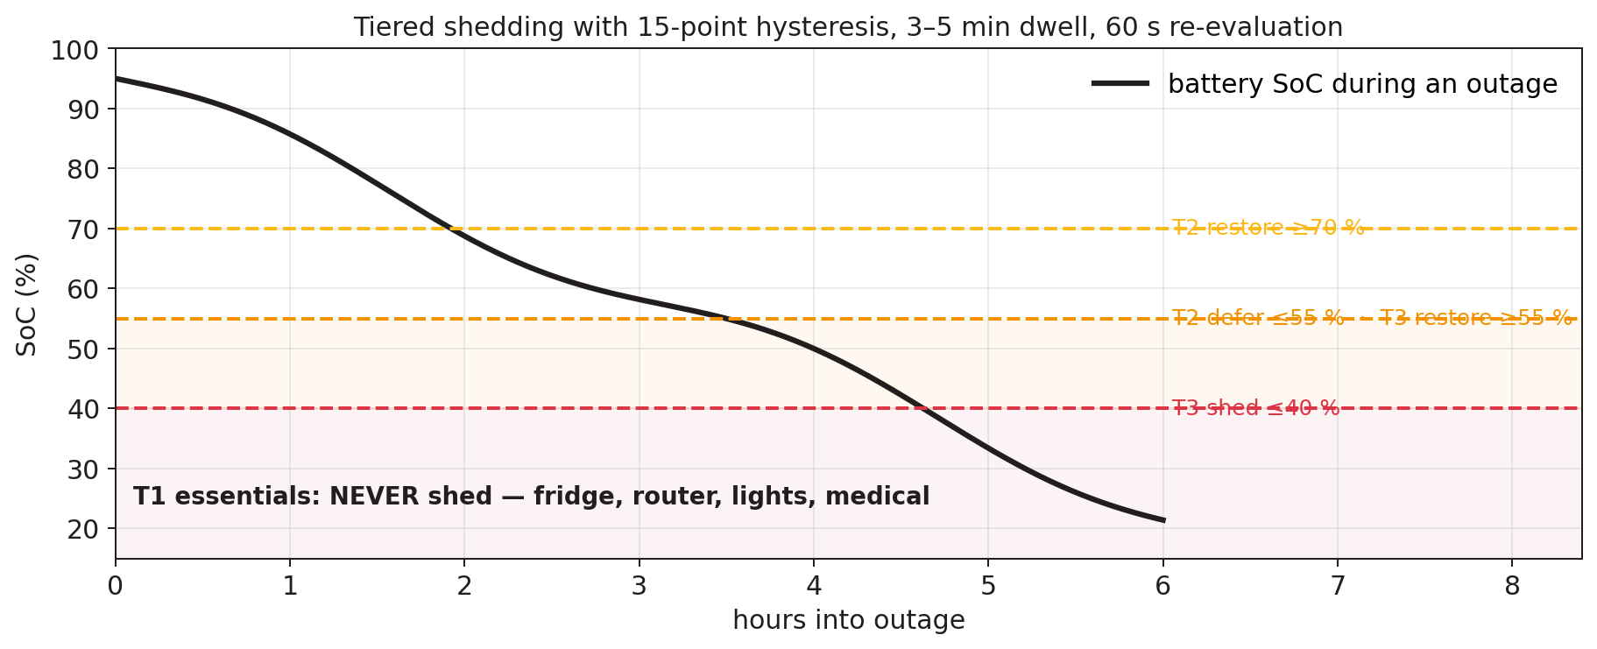
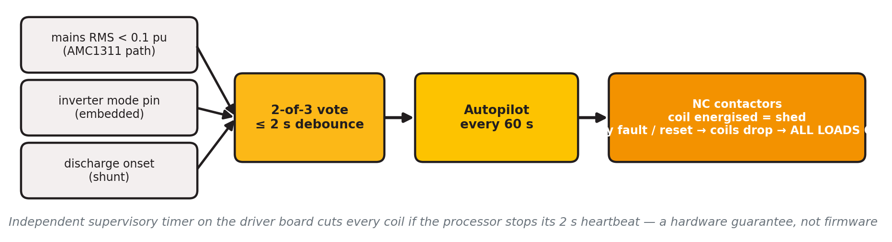
Engine 2 · Autopilot: essentials alive, fail-safe always
▪ Learns, transparently: hour-of-week load and outage tables (4.7 KB) — a judge can read them; single-home load is too noisy for a neural forecaster to beat them
▪ Forecasts the roster, not the storm: scheduled cuts are predictable from the home's own history; faults are detected, not predicted
▪ Tiers: T1 never shed · T2 defer at 55 % · T3 shed at 40 %, 15-point hysteresis, 3–5 min compressor dwell, 30-min user override that cannot beat the safety floor
▪ Measured: 65 tests, 50/50 scripted scenarios in C, zero chatter, zero dwell violations
V-Guard Sentinel · Big Idea Tech 2026, Track 4 · Team Codey Tingle (TI3271)
8

Slide 9
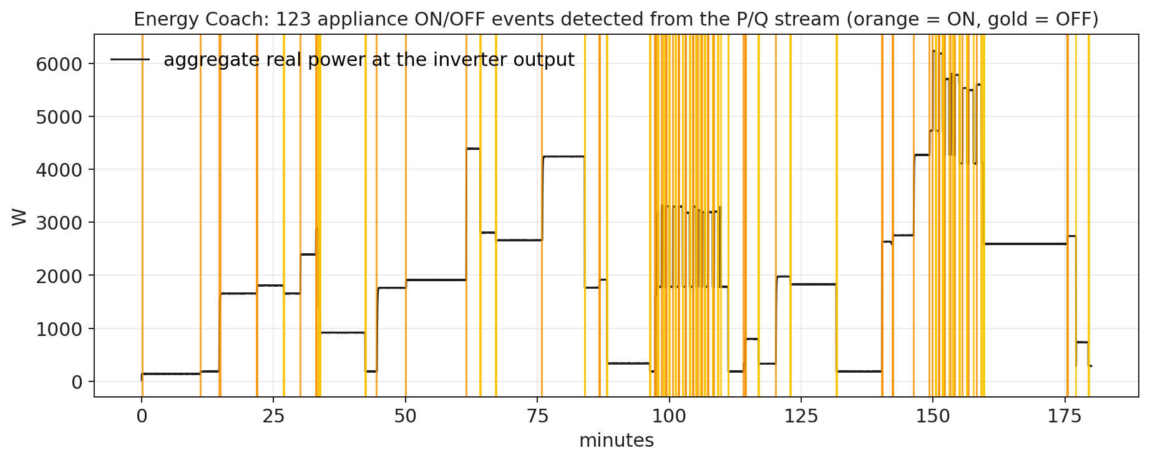
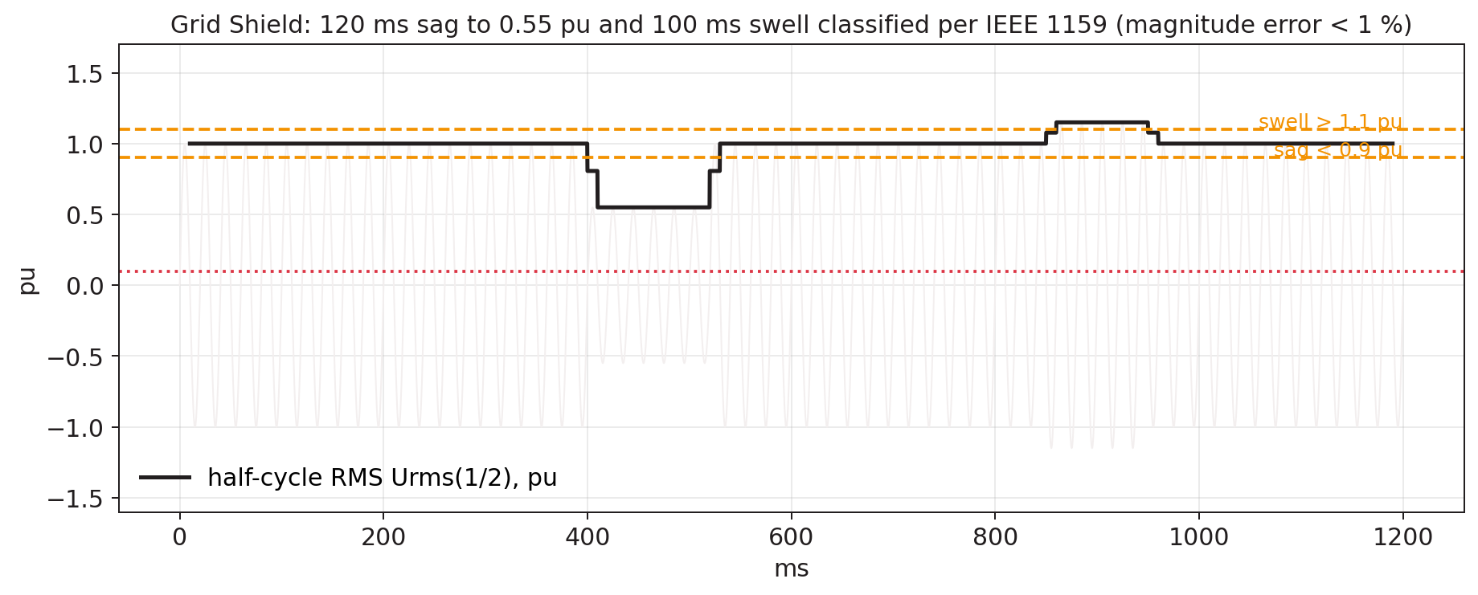
Engine 3 · Energy Coach and Grid Shield
Both need one thing the report's first BOM lacked: a real metering front-end on the AC output — now designed in
▪ How the ESP32 tells appliances apart: each ON/OFF step becomes a 13-number signature — ΔP, ΔQ, phase angle, inrush ratio, settling time, harmonic share, duration, periodicity
▪ Per-home library: rules + k-NN, seeded from an Indian appliance table, grown by clustering, named by the user (“what just turned on?”)
▪ Honest scope: fridge, AC, geyser, pump, iron/kettle class — not two identical fans, not loads under 40 W
▪ Half-cycle RMS on an isolated tap, IEEE 1159 buckets, 4-cycle FFT for THD; Class-S-like, never “Class A”
▪ Measured: 13/13 dips detected, magnitude error < 1 %, duration error 0 half-cycles; event recall 1.00, fridge F1 0.97
▪ Value: a dated, signed record of utility-caused events — appliance-protection evidence, not a trip
V-Guard Sentinel · Big Idea Tech 2026, Track 4 · Team Codey Tingle (TI3271)
9

Slide 10
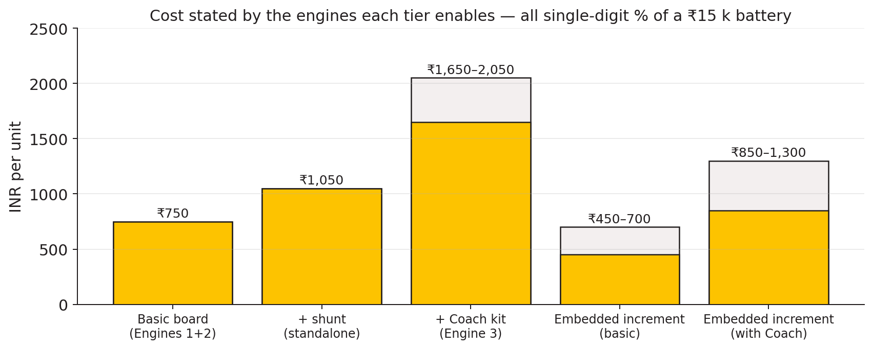
The product: two SKUs, one board
Embedded in new V-Guard inverters, or a 30-minute electrician retrofit on the installed base
Sentinel-Embedded
Daughter-board inside the inverter. Kelvin-taps the inverter's own shunt; controls the charger through a DAC on the PWM feedback node with a hardware voltage/thermal ceiling. Adaptive charging and the life-extension claim live here only.
Sentinel-Retrofit
Box beside the inverter: external 0.1 mΩ shunt in the battery negative lead, NTC on the battery, CT + voltage tap on AC-OUT, 4 fail-safe contactor channels. Advisory on charging, protective on loads. ~2.6 mA average draw — 0.04 % of a 150 Ah battery per day.
Parts added versus the submitted report: ATM90E32AS metering AFE + CT, DS3231 clock, ATECC608 secure element, driver-board supervisory timer. Every part is tied to the engine it enables.
V-Guard Sentinel · Big Idea Tech 2026, Track 4 · Team Codey Tingle (TI3271)
10

Slide 11
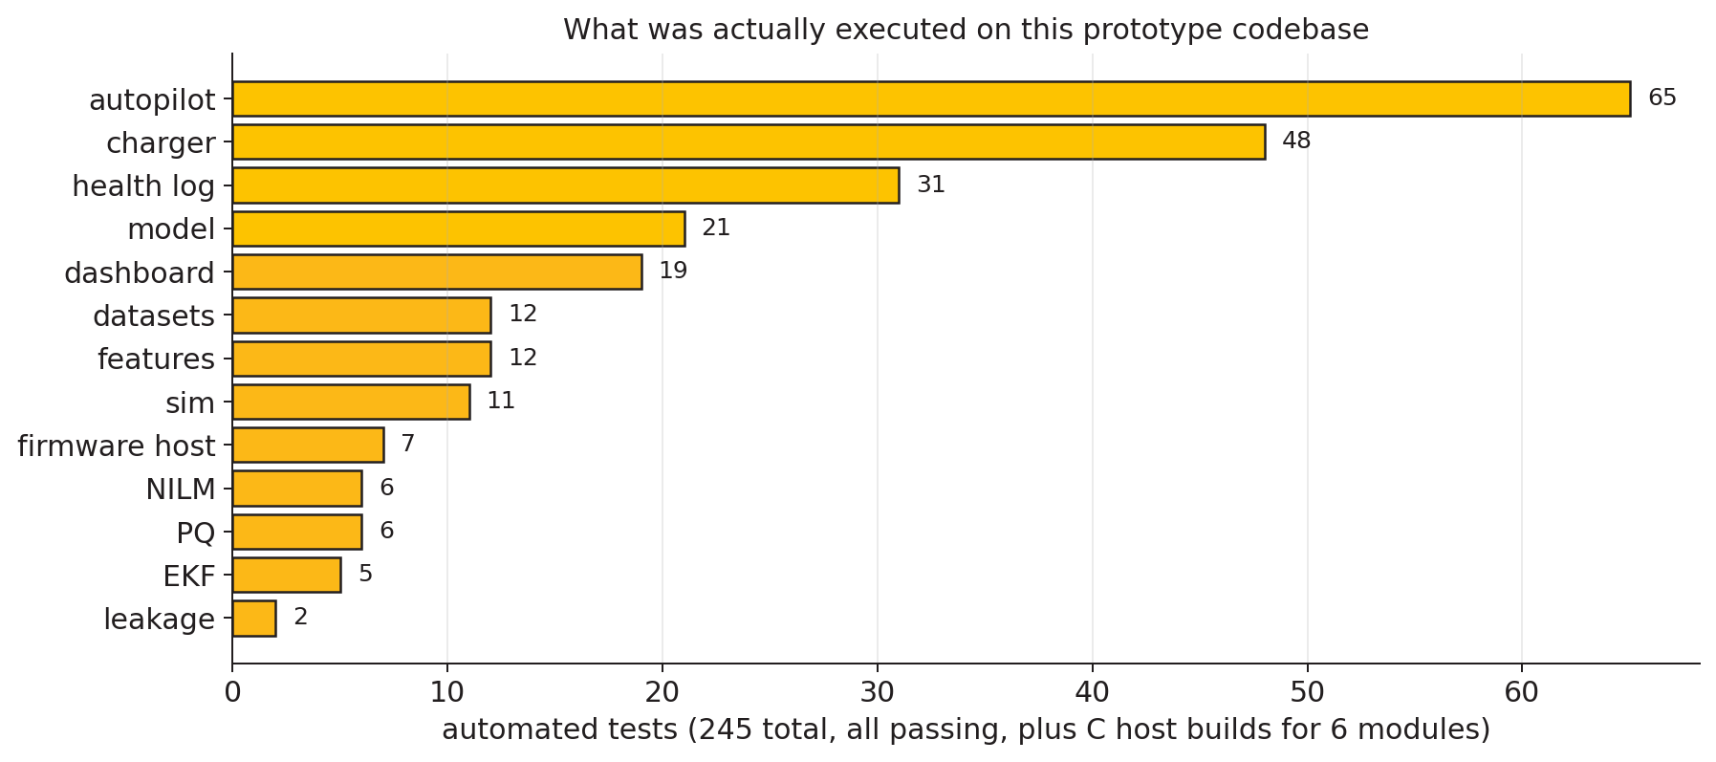
The prototype: what actually runs
Not a slide deck — a codebase: every engine implemented in Python and C, tested, with the same C linked into the firmware
▪ Simulator + features: synthetic Indian tubular duty cycles at 1 Hz → 14 + 6 physics features per outage cycle
▪ Model pipeline: train → evaluate → int8 quantise → full-int8 .tflite (3 seeds), independent test split, leakage guard
▪ EKF, autopilot, NILM, PQ, health log, charger policy: Python reference + C99 port, bit-identical outputs
▪ Firmware: ESP-IDF project with the real task map; a host build links every C module, passes an int8 golden self-test and feeds the dashboard
▪ Dashboard: Flask + one page; scripted finale sequence or live file from the device
▪ Reproducible: run_all.sh regenerates every number; pinned dependencies; private GitHub repo
V-Guard Sentinel · Big Idea Tech 2026, Track 4 · Team Codey Tingle (TI3271)
11

Slide 12
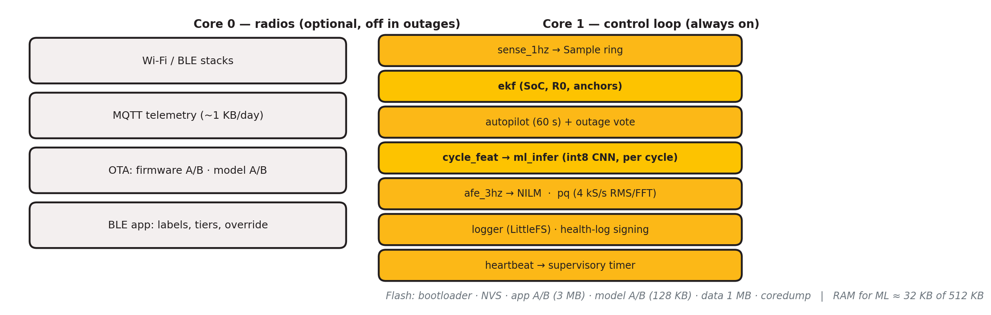
Self-contained by construction
Unplug the router for a year: every row below still works. The cloud only adds updates and fleet learning
Fixed int8 weights in flash · 16 KB arena · one inference per outage cycle · plain C turns quantiles into “replace in 6–14 weeks” · no training on the device, ever.
V-Guard Sentinel · Big Idea Tech 2026, Track 4 · Team Codey Tingle (TI3271)
12

Slide 13
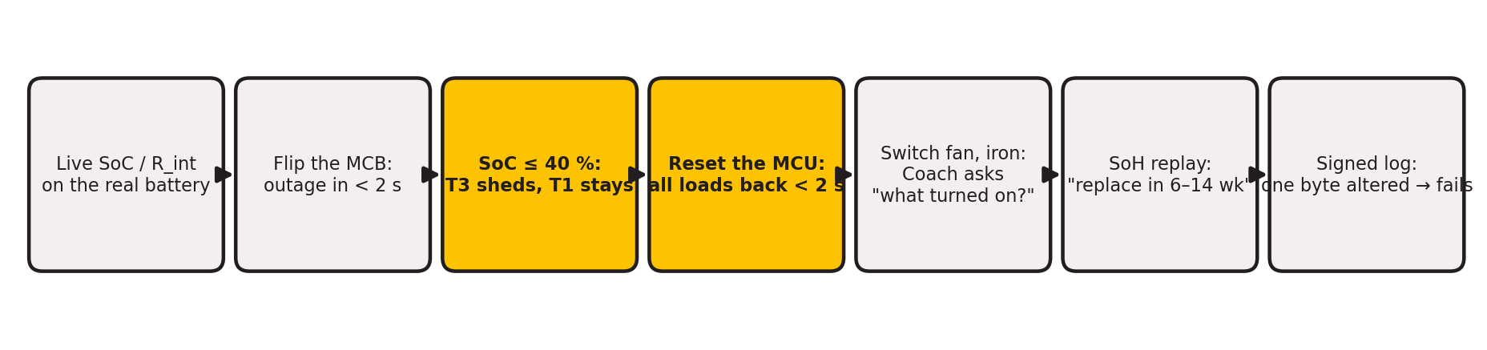
Live demonstration
A real 12 V tubular battery and inverter on the table; three relay-switched load tiers; nothing connected to the internet
▪ Real: SoC and internal resistance from the shunt and Kalman filter; outage detection; tiered shedding; fail-safe restore on reset; appliance events; signed log verification
▪ Replayed and labelled as such: the state-of-health walk to “Replace within N weeks” uses a synthetic aging trajectory — a bench battery does not age in a week
▪ Deliberately absent: federated learning (on hold), charger control on a retrofit inverter (no interface exists), loads under 40 W
V-Guard Sentinel · Big Idea Tech 2026, Track 4 · Team Codey Tingle (TI3271)
13

Slide 14
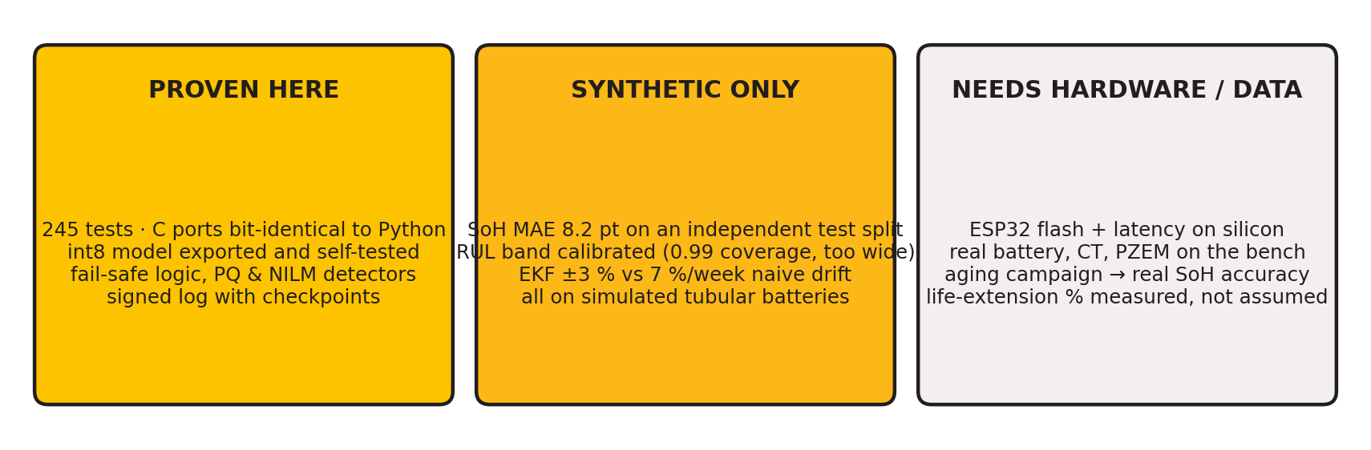
Proven · synthetic · still needs hardware
We separate what is deployable today from what is a research target — credibility is the whole game
▪ Corrections we made to our own report after building it: float voltage is not open-circuit voltage; a battery shunt cannot see appliances; adaptive charging is embedded-only; federate the model that has labels on the device
▪ Every claim traces to a script in the repository and to a design decision (D1–D17) in the design register
V-Guard Sentinel · Big Idea Tech 2026, Track 4 · Team Codey Tingle (TI3271)
14

Slide 15
Roadmap as validation gates, and the ask
Gate 1 · Dataset
Gate 2 · Field pilot
Gate 3 · Learning stability
24–36 tubular batteries, 3 temperatures × 3 depths × 2 regimes, 6–8 months in the Kochi reliability lab. Output: EKF tables, real SoH labels, the measured life-extension ratio.
100 retrofit units, 6 months: SoC within 3 % on reference shunts, ≥ 75 % RUL-window hit-rate, zero unsafe sheds, fridge/AC F1 ≥ 0.8, power within budget.
Three model releases with no regression on a golden slice; embedded SKU into the Smart Pro family with its existing Wi-Fi/BLE and app.
▪ What V-Guard gains: timely battery replacement revenue, warranty decided from evidence, a premium “intelligent” tier, and a fleet-data moat no competitor can buy
▪ What we need: the ESP32-S3 bench hardware, one opened Prime-series inverter with its charger-board schematic, batteries and cyclers for Gate 1
V-Guard Sentinel · Big Idea Tech 2026, Track 4 · Team Codey Tingle (TI3271)
15

Slide 16
Coil off means loads on.
A window, never a date.
Offline first, fleet second.
V-Guard Sentinel — Team Codey Tingle (TI3271)
Design register: 17 decisions · Prototype: 245 automated tests, 6 C modules, full-int8 model, firmware host build
github.com/epshukla/vguard-sentinel (private)

